Slide 1


welcome to
Freshman orientation
AUGUST 2024

Slide 2
















Fan Club Mission Statement: The FAN ( Future
Artist network) Club includes Alumni, Parents, Faculty & Staff who support students, faculty & programs in the dance, instrumental, choral,
technical, theatrical, and visual arts majors.
Our purpose is to raise awareness of events and
programs, fundraise to support programs and
help with facility and equipment upgrades in our
www.pccafanclub.com
two theaters on campus.
PCCAFanClub
@pccafanclub

Slide 3


Slide 4
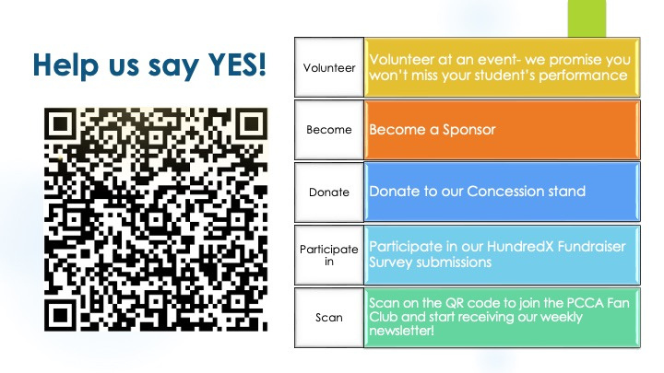

Slide 5


Slide 6










Slide 7

Who to See?
Arts
Classroom Arts Teacher
Arts Department Chair
Ms. Natalie Calderon, School Counselor
Mr. Vasallo, Program Director
Mr. Brown, Principal

Slide 8
Who to See?
Academics
Classroom Teacher
Natalie Calderon, School Counselor
Mr. Vasallo, Program Director
Mrs. Johnson & Mr. Machado
Mr. Brown, Principal

Slide 9
Who to See?
School Issues
Grading issues? Contact the teacher first
School Counselor - Academics, Scheduling, & Social Issues
Mr. Vasallo - Program Policy & Discipline

Slide 10

PCCA Senior Survey

Slide 11

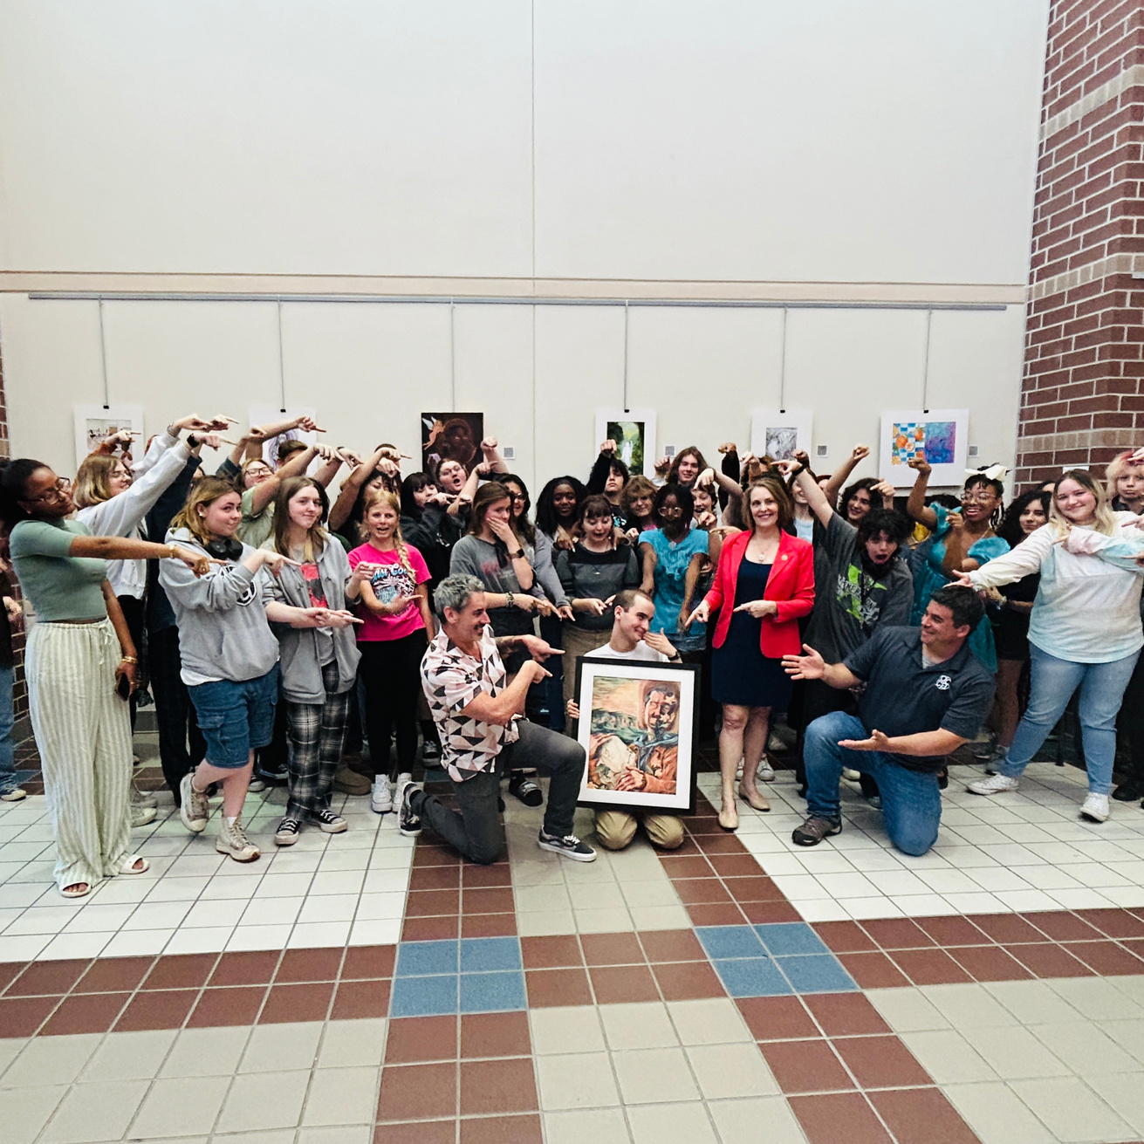
What is the best thing about the PCCA Program?
Sense of Community - 44%
Trips & Experiences - 19%
Personal Achievements - 18%

Slide 12
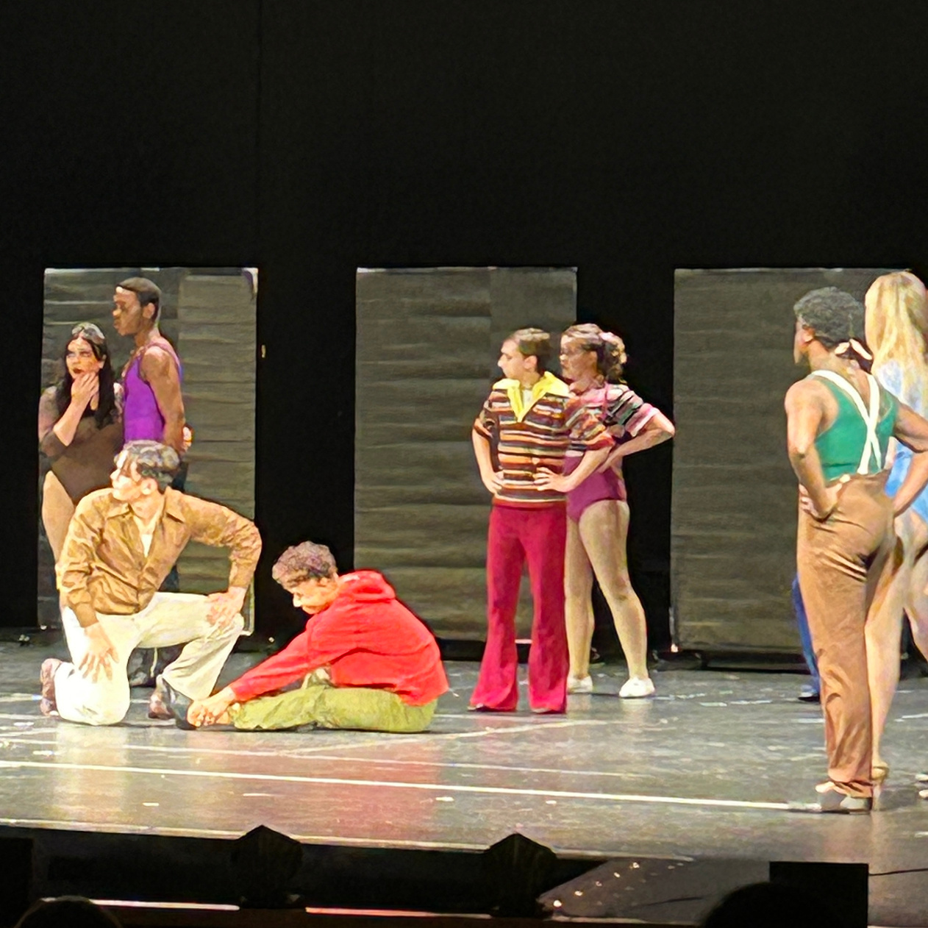
What was the biggest challenge you faced in the PCCA program?
Finding Balance - 29%
Personal Challenge - 24%
Staffing Changes - 17%
Competition - 15%

Slide 13

What advice would you give to your freshman self?
Be more motivated - 31%
Chill out/Watch your Mental Health - 31%
Practice - 11%

Slide 14
how to be successful in

Slide 15

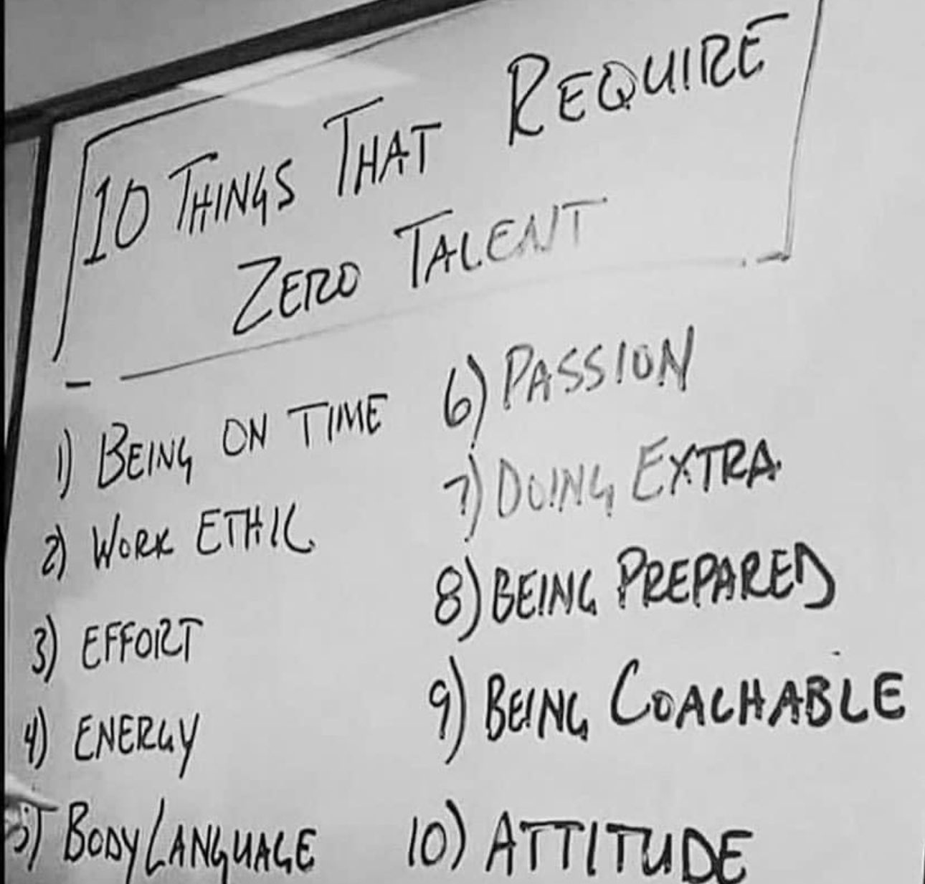

Slide 16
PROGRAM STATUS
In order to remain in the program, students must meet the following requirements:
Complete all required courses
Avoid Excessive Absences
Avoid Disciplinary Referrals
Maintain a 2.5 GPA overall
Maintain a 3.0 GPA in PCCA Courses
Fulfill extended hours requirement
Pass semester Juries
Failure to meet these requirements will lead to alert, probation, and finally dismissal from the program.

Slide 17
JURIES
•Juries are auditions that you complete each semester while you are enrolled in PCCA.
•You will be graded on your progress and growth as an artist.
•If you fail to score at least a 7 out of 10, you will be put on probation. A second jury failure will lead to dismissal.
•If you do not complete your jury, you will be automatically dismissed from PCCA and sent back to your zoned school.
•You should start preparing for your juries early in the semester.

Slide 18
EXTENDED HOURS
•In order to complete required curriculum and performances, students will be required to log their hours outside of the school day for studio time, rehearsals, and experiences
•They will also be required to log hours for experiences outside of their arts major
•Each major has specific information about how to document and fulfill this requirement

Slide 19
ALERTS
•Alerts usually come out mid-semester
•If you receive a Alert, it means you are not meeting the program standards and you are in danger of being put on probation.
•If you are put on Alert, it means you have a problem and you need to fix it as soon as possible.
•You should talk to your core arts teacher about how you can correct the problem

Slide 20
PROBATION
•If you do not correct the problem you were alerted about, or you fall below the standards in the first semester, you will be placed on Probation at the semester break.
•If you do not correct the problem while on probation, you may be dismissed after one semester and sent back to your zoned school.

Slide 21
PROBATION
•You may be placed on probation without an alert if you:
•Fail your jury
•Fail to turn in extended hours
•Commit a major code of conduct violation

Slide 22
REASONS FOR PROBATION
Extended Hours - 68%
Arts GPA (3.0) - 32%
GPA (2.5) - 32%
Jury Score - 21%
Attendance - 16%
Behavior - 5%

Slide 23
DISMISSAL
•If you are unable to correct your problem while on probation, you will be dismissed from the program.
•Dismissed students must return to their close-to-home school.

Slide 24
ATTENDANCE
A student who is not present in class at least one half of the class period shall be counted absent from that class.
To be counted present for the school day, a student must be in attendance for at least one half of the class periods during the school day.

Slide 25
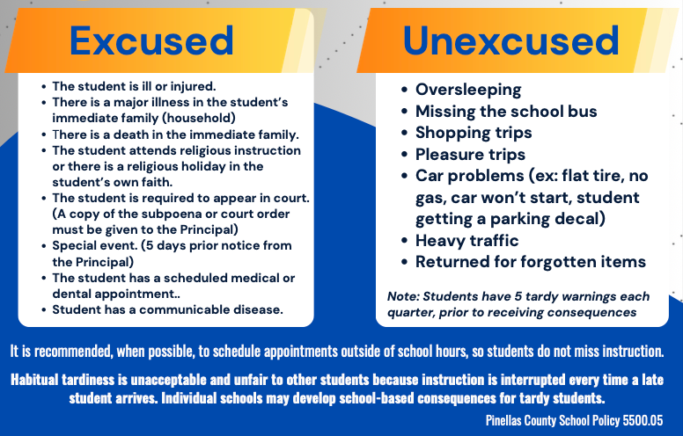

Slide 26
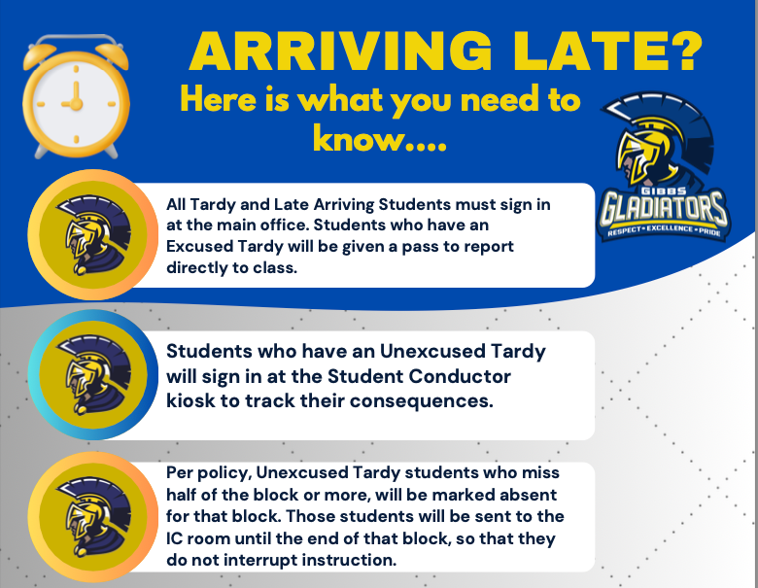

Slide 27

ATTENDANCE
15 unexcused absences within 90 days will result in a students’ driver’s license being revoked
Attendance is crucial for grades and for progress to remain above average
Poor Attendance may also impact Jury Score for the program
Students with chronic absence and tardy issues should not be surprised to see low grades

Slide 28
REFERRALS - SESIR INCIDENTS
Alcohol
Aggravated Battery
Arson
Bullying
Burglary
Criminal Mischief
Disruption on Campus
Drug Sale
Drug Use
Fighting
Grand Theft
Harassment
Hazing
Homicide
Kidnapping
Robbery
Sexual Assault/Battery
Sexual Harassment/ Offenses
Simple Battery
Threat/ Intimidation
Tobacco
Trespassing
Weapons Possession

Slide 29
REFERRALS - SESIR INCIDENTS
Alcohol
Aggravated Battery
Arson
Bullying
Burglary
Criminal Mischief
Disruption on Campus
Drug Distribution
Drug Use
Fighting
Grand Theft
Harassment
Hazing
Homicide
Kidnapping
Robbery
Sexual Assault/Battery
Sexual Harassment/ Offenses
Simple Battery
Threat/ Intimidation
Tobacco (Vaping)
Trespassing
Weapons Possession

Slide 30


BULLYING

Slide 31
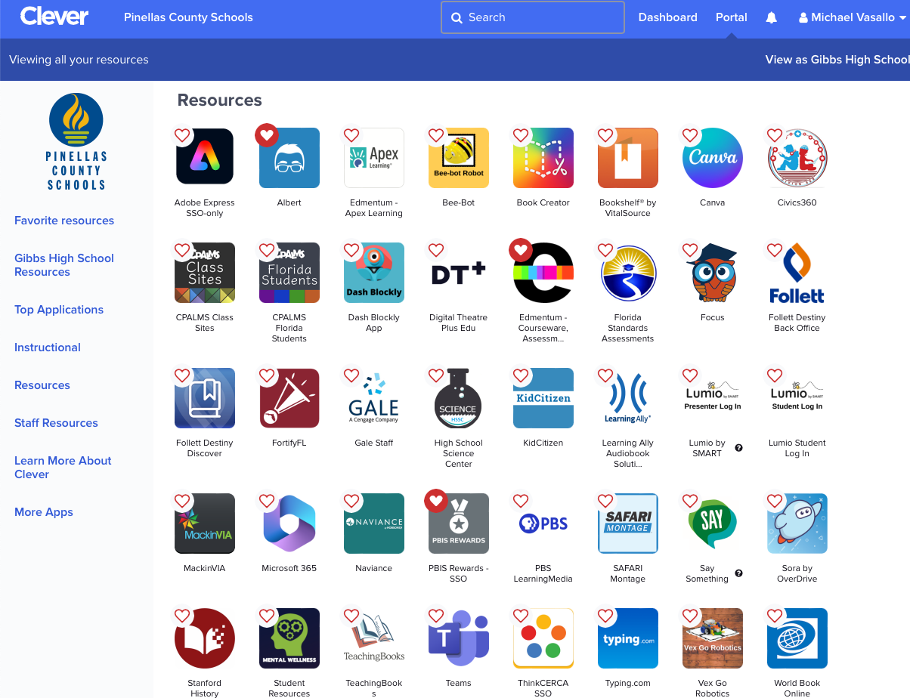


Slide 32

DRESS CODE
Pinellas County Schools Dress Code
https://www.pcsb.org/dresscode

Slide 33
ARTIFICIAL INTELLIGENCE
Cheating is defined in the Code of Conduct as:
The act of inappropriately and deliberately distributing or using information, notes, materials, or work of another person in the completion of an academic exam, test, or assignment. Not telling the truth.
All work submitted must be in the student’s own words.
The use of artificial intelligence applications such as ChatGPT, Grammarly, and many others to write assignments will be considered cheating
Consequences include receiving a referral and a zero on the assignment

Slide 34
EXAM EXEMPTIONS
· All high school courses that do not have a state required end-of-course assessment (EOC), will have a final exam
· Students who do not take the final exam in a particular course, will receive a failing grade

Slide 35
EXAM EXEMPTIONS
· Students can exempt up to 3 courses that have a provisional semester grade of "A", "B", or “C" AND fewer than 4 unexcused absences

Slide 36
EXAM EXEMPTIONS
· For all high school courses that have a state required end-of-course assessment, the semester 1 final examination will be a district-developed common assessment, taken by all students enrolled in the course, and the end-of-year examination will be the state end-of-course assessment (EOC).
9th Grade English, 10th Grade English, Algebra, Biology, Geometry, US History
· AP/AICE courses: Students are required to take the first semester exam. The second semester exam will be the AP/AICE exam.

Slide 37
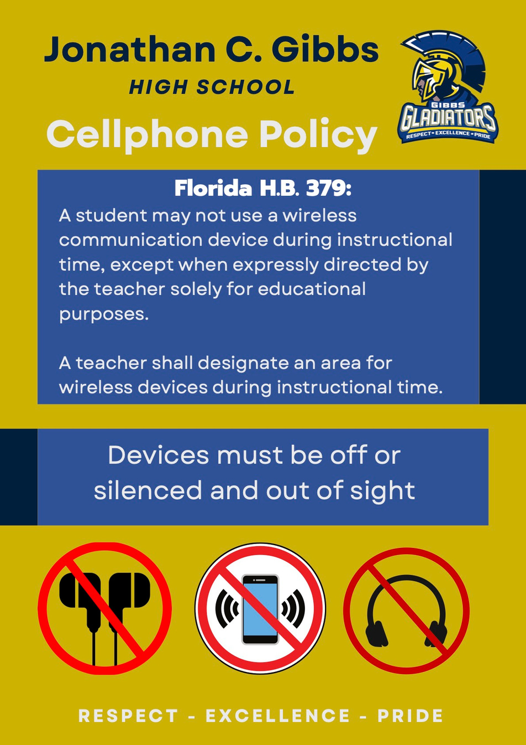
Headphones are only allowed during lunch
Not allowed during class time or during class changes

Slide 38


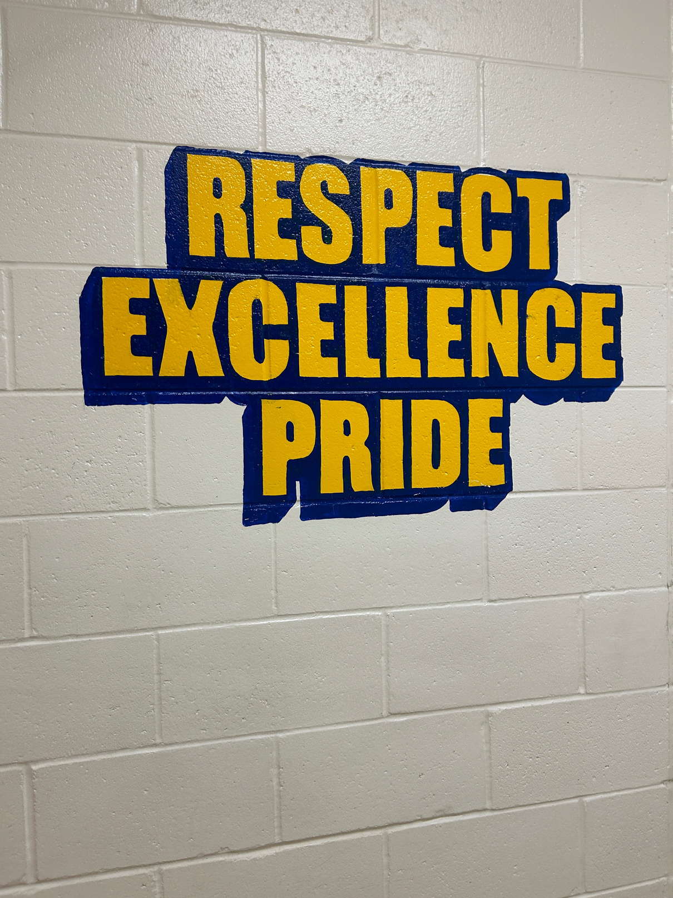
How to be a Gladiator!

Slide 39

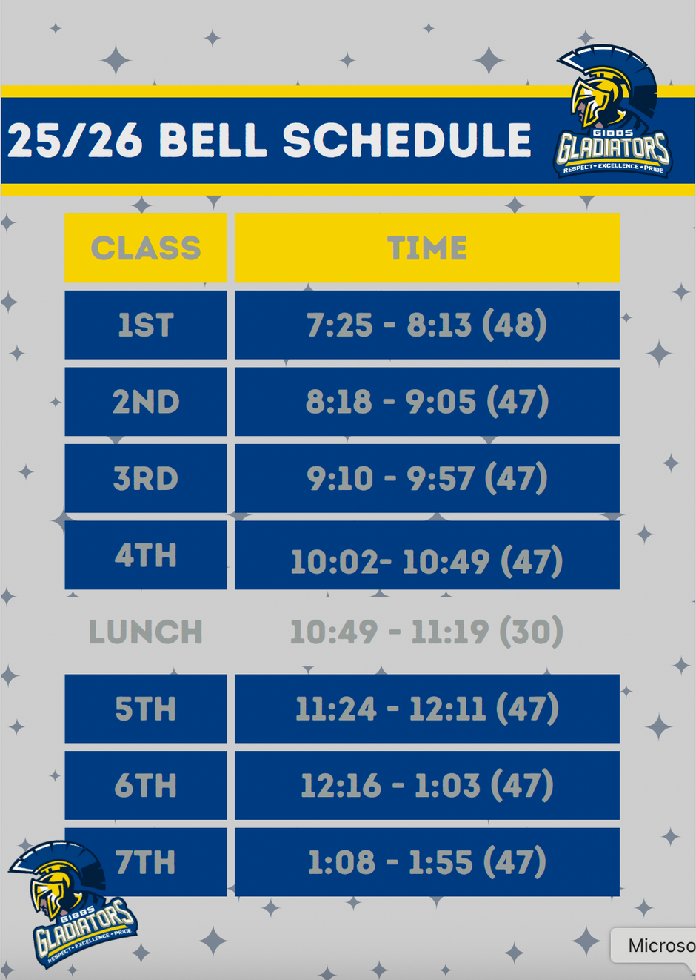
Bell Schedule

Slide 40
Lunch
•One Lunch, lasting 30 minutes
•Students will be allowed to be in the Cafeteria, and the Courtyard
•Many teachers conduct tutoring during lunch. All students who attend tutoring must:
Have a pass
Bring a lunch
Report directly to the tutoring classroom

Slide 41
Lockers
•Hallway lockers are available - see Mrs. Gilbert
•No classes require textbooks
•Dance Dept. has lockers - Use a Lock!
•PE locks are sold by PE teachers

Slide 42
Backpacks
•Backpacks are allowed and encouraged.
•Keep your personal items with you at all times

Slide 43
Parent Drop Off/Pick Up
•Parent drop off and pickup is in the 34th Street Lot
•Cars line up in the far right northbound lane of 34th Street South
•Drop off moves fairly fluidly in the morning – peak time is around 7:00 am
•Students must be in class at 7:10am
•Same Car Circle in the afternoon, but cars cue up in the South Parking lot to keep traffic moving on US 19
There is also a car circle on 31st Street

Slide 44
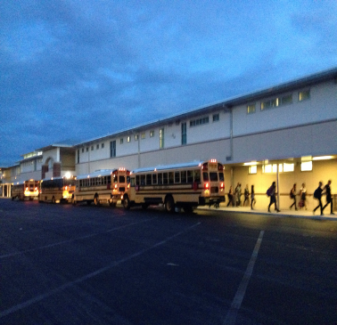
Bus Transportation
•Buses depart at 2:06 sharp!
•Remain on sidewalk until your bus is ready for loading
•Ride only your bus – students may not ride a friend’s bus home
•Honor bus rules - Transportation is a privilege!

Slide 45
MR. VASALLO’S ADVICE
Zeroes are grade killers
Stay on top of deadlines - don't procrastinate!
Cell Phones and Social Media are a HUGE distraction and create/encourage the wrong kind of drama
Do not “hold anything” for a friend
You WILL receive feedback - use it to make yourself better
Start preparing early for your juries
Get involved - don’t sit back!

Slide 46


Slide 47


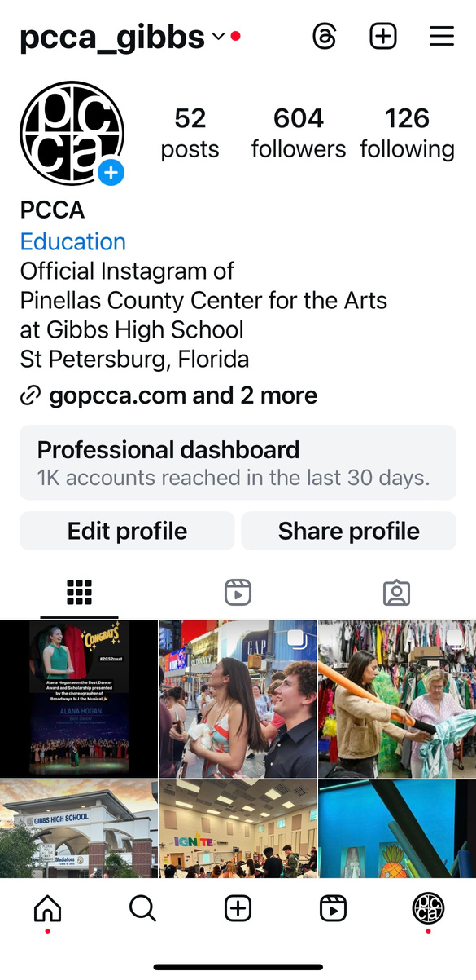
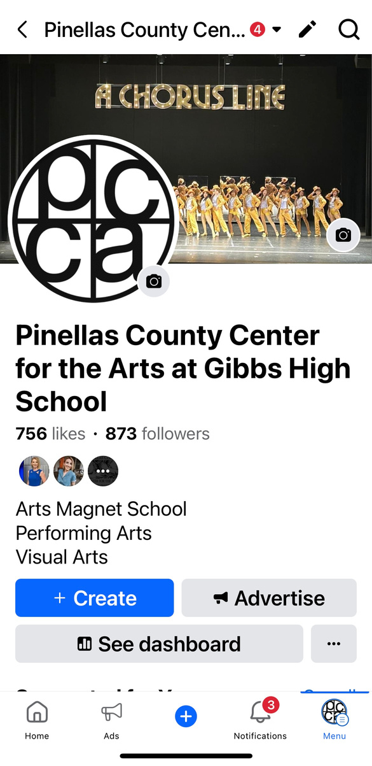
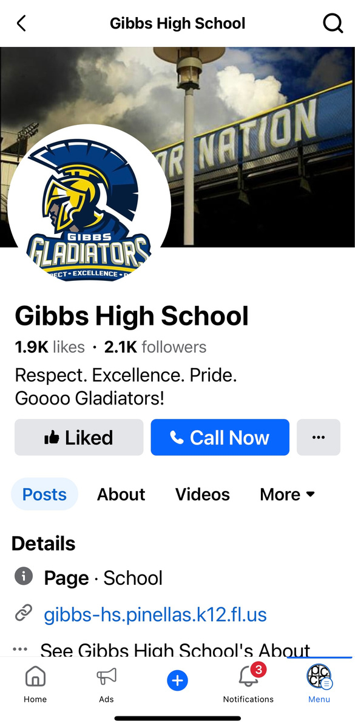
Follow Us!

